Slide 1
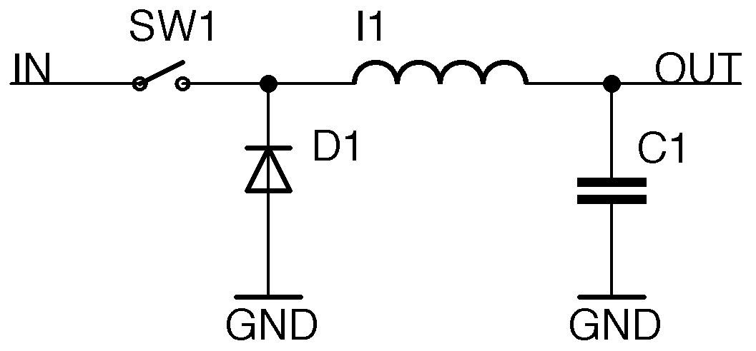
Introduction to Buck Regulators
An Overview and Exploration
By Francisco De La Paz

Slide 2
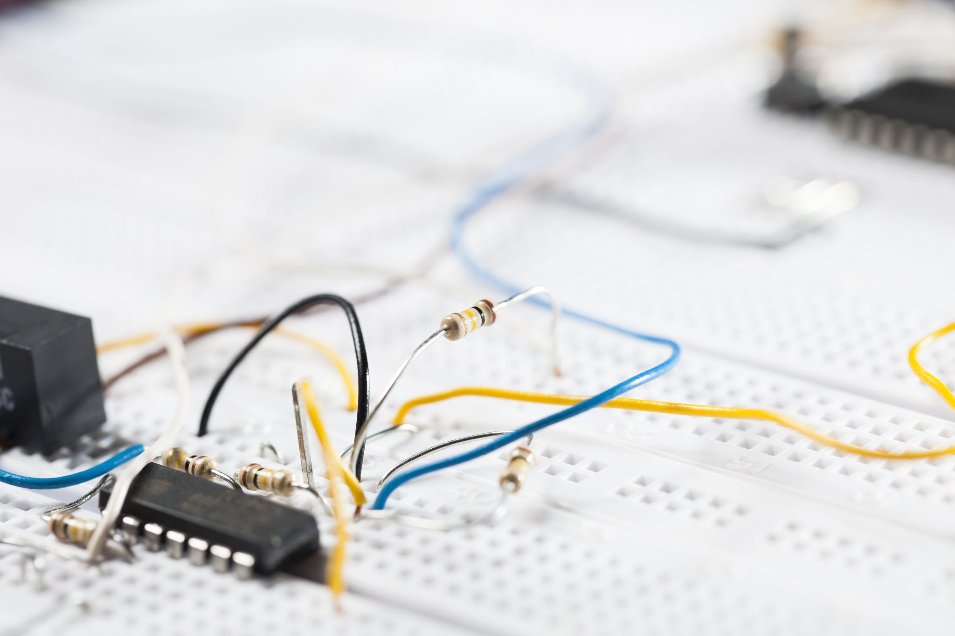
A buck regulator, also called a step-down converter, transforms higher input voltage to a lower, regulated output. It uses components like inductors and capacitors to maintain this output, regardless of input fluctuations. Why did the diode go to the beach? To get tanned!

Slide 3
The buck regulator is pivotal in modern electronics. From power supplies in computers to smartphones, its efficiency makes it indispensable. Its primary role in battery-powered devices is to extend battery life, a crucial function in today's mobile age. Why did the resistor hug the capacitor? For current support!

Slide 4
The buck regulator's foremost advantage is high efficiency, especially with minimal input-output voltage difference. This efficiency curtails heat generation, prolongs device life, and minimizes cooling needs. Modern designs even allow for more compact system designs. Why don't electrical engineers get shocked? They're well-grounded!

Slide 5
Despite its merits, the buck regulator has setbacks. Rising switching frequencies can result in electromagnetic interference, complicating designs. Proper component selection is paramount, and specific designs might face limitations in voltage differentials. What did the transformer say to the inductor? 'Feeling current today?'

Slide 6
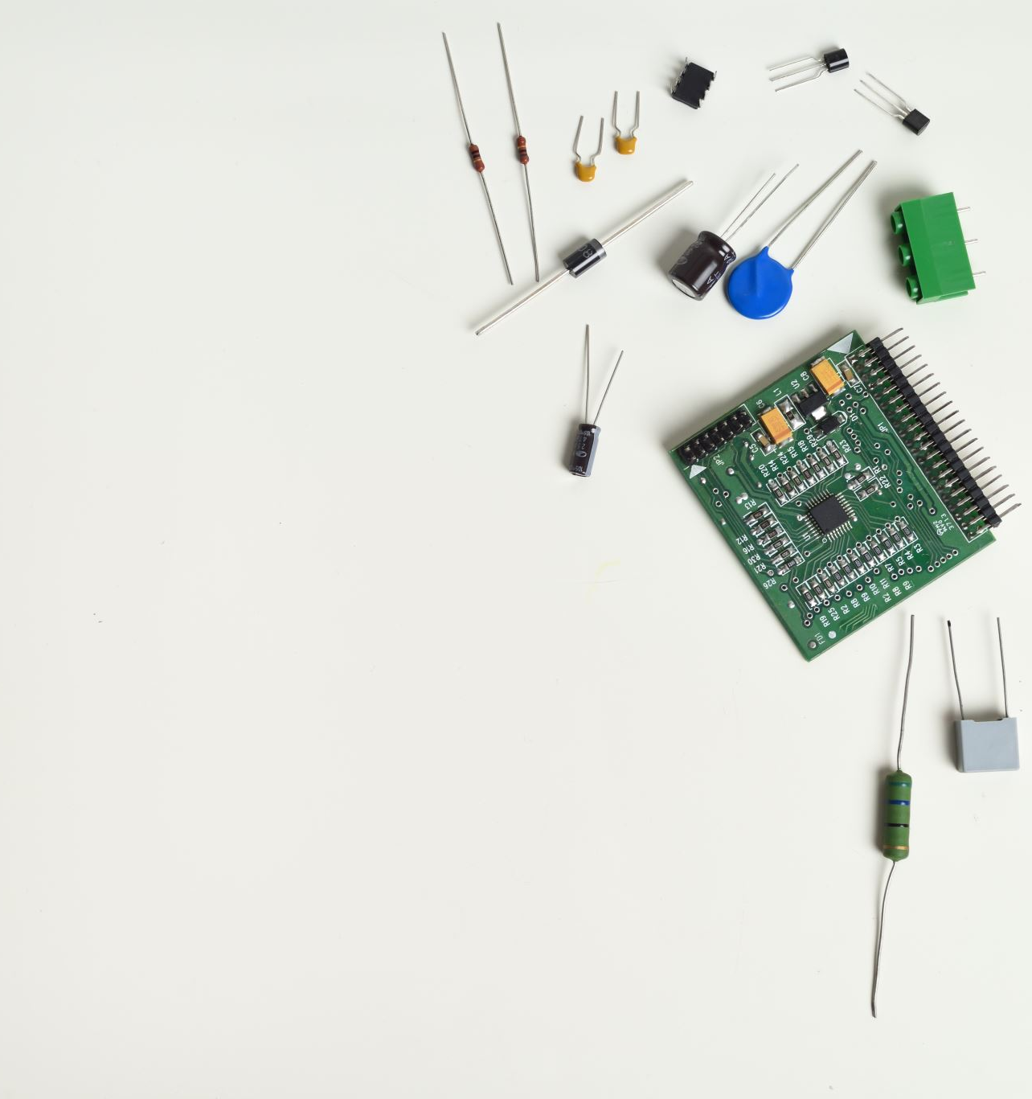
Buck regulators have evolved with variations like synchronous buck regulators and multiphase designs. These aim at specific challenges or applications, offering advanced solutions and integrating control circuits for a more compact footprint. Why did the transistor go to school? To amplify its knowledge!

Slide 7
References
Knight, D. (2015, November 24). Buck converters and their cool applications - technical articles. All About Circuits. https://www.allaboutcircuits.com/technical-articles/buck-converters-and-their-cool-applications/
Bell, B., &amp; Pace, D. (2016, September). Buck regulator topologies for wide input/output voltage differentials. Dallas; Texas Instruments.
Buck regulators. STMicroelectronics. (n.d.). https://www.st.com/en/power-management/buck-regulators.html
ICRFQ.com. (2022, May 23). Everything you need to know about Buck Converters. icrfq.net. https://www.icrfq.net/buck-converters/

